Slide 1

Predictive Modeling of Salmonella enteritidis Growth Under Sinusoidal Temperature
Modified Gompertz Model & OLS Parameter Estimation
Introduction & Background Model Description Data Overview Forward Problem Parameter Selection OLS Results Model Diagnostics Optimal Experime
ntal Design Bootstrapping
Conclusions
Boyuan Zhao, Wenyu Xu, Yizhou Li
College of Biosystems Engineering and Food Science Zhejiang University
April 14, 2026
Salmonella Gompertz Model

Slide 2
Introduction & Background Model Description Data Overview Forward Problem Parameter Selection OLS Results Model Diagnostics Optimal Experime
ntal Design Bootstrapping
Conclusions
目录
1 Introduction & Background
2 Model Description
3 Data Overview
4 Forward Problem
5 Parameter Selection
6 OLS Results
7 Model Diagnostics
8 Optimal Experimental Design
9 Bootstrapping
10 Conclusions
11 References
Salmonella Gompertz Model

Slide 3
Introduction & Background
Introduction & Background Model Description Data Overview Forward Problem Parameter Selection OLS Results Model Diagnostics Optimal Experime
ntal Design Bootstrapping
Conclusions
Salmonella enteritidis is a major foodborne pathogen in egg products
Temperature fluctuations during storage/transport affect microbial growth
Reference: Gumudavelli et al. (2007), J. Food Sci. 72:M254–62 [1]
Objective
Use a modified Gompertz model to predict Salmonella growth under sinusoidal heating, estimate model parameters via OLS, and evaluate model adequacy.
Salmonella Gompertz Model

Slide 4
Model Description
Introduction & Background Model Description Data Overview Forward Problem Parameter Selection OLS Results Model Diagnostics Optimal Experime
ntal Design Bootstrapping
Conclusions
Primary Model (differential form)
d log N ( )
= µ · K · C · exp(−K), K = exp −µ(t − M)
(1)
dt
Secondary Model (growth rate vs. temperature)
µ = a(T − T_{min})²⁽1 − exp[b(T − T_{max})]⁾
Dependent variable: log₁₀ N(t) —log microbial concentration (log cfu/mL)
Independent variable: t —time (hr)
(2)
Salmonella Gompertz Model

Slide 5
Model Description —7 Candidate Parameters
Introduction & Background Model Description Data Overview Forward Problem Parameter Selection OLS Results Model Diagnostics Optimal Experime
ntal Design Bootstrapping
Conclusions
Parameter
Symbol
Description
Units
Initial Guess
A C M
a b
Tmin Tmax
A C M
a b
Tmin Tmax
Initial log microbial number Upper–lower asymptote difference Inflection point time
Secondary model coeﬀicient
Secondary model coeﬀicient Minimum growth temperature Maximum growth temperature
log cfu/mL log cfu/mL hr
_{C}−2 _{hr}−1
_{C}−1
_{C}
_{C}
log₁₀(400) ≈ 2.60
11
7.5
0.000338
0.275
6
46.3
Salmonella Gompertz Model

Slide 6
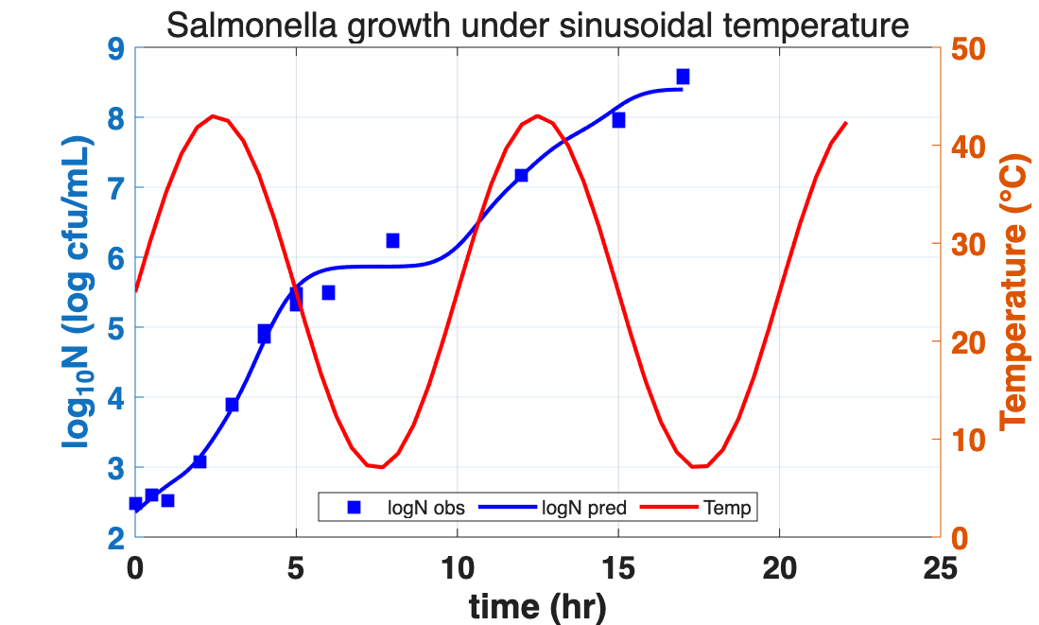
Data Overview
Introduction & Background Model Description Data Overview Forward Problem Parameter Selection OLS Results Model Diagnostics Optimal Experime
ntal Design Bootstrapping
Conclusions
Growth data:
log₁₀(CFU/mL), n = 20
Temperature: sinusoidal
T(t) every minute
Two independent time vectors
Fig 1. Dual-axis: log₁₀ N (observed & predicted) and T vs. time
Salmonella Gompertz Model

Slide 7
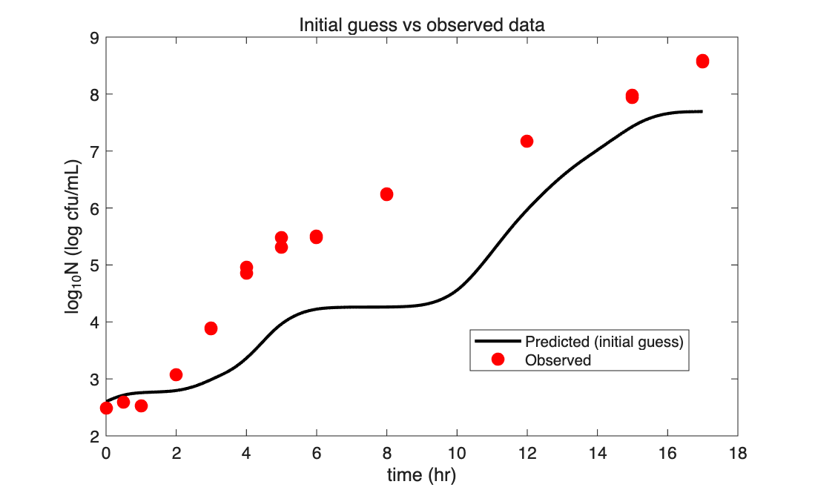
Forward Problem —Initial Guess
Introduction & Background Model Description Data Overview Forward Problem Parameter Selection OLS Results Model Diagnostics Optimal Experime
ntal Design Bootstrapping
Conclusions
All 7 guesses from literature
ODE solved with ode45
T(t) interpolated via
interp1
Fig 2. Initial guess vs. observed data
Salmonella Gompertz Model
7 / 18

Slide 8
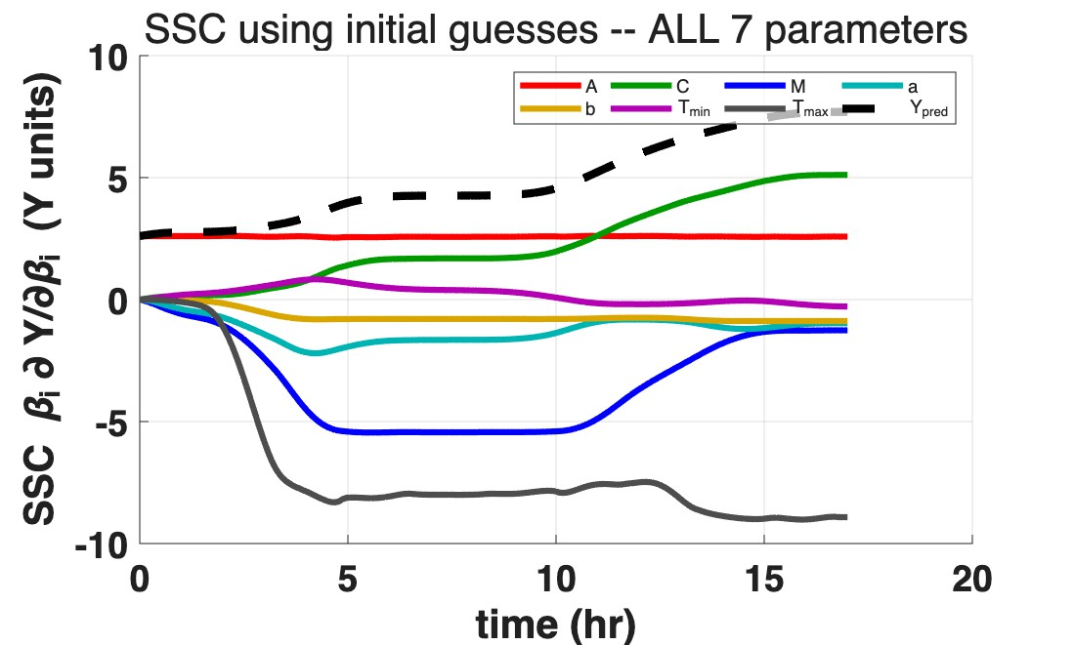
SSC Analysis —All 7 Parameters (Step 1)
Introduction & Background Model Description Data Overview Forward Problem Parameter Selection OLS Results Model Diagnostics Optimal Experime
ntal Design Bootstrapping
Conclusions
Max|SSC|:
Param
Max|SSC|
A C M
a
b
Tmin Tmax
2.61
5.11
5.45
2.20
0.88
0.83
9.02
Decision
T_{min} (0.83) and b (0.88): lowest SSC ⇒ fix:
T_{min} = 6 ◦C, b = 0.275.
Fig 3. SSC for all 7 parameters
Salmonella Gompertz Model

Slide 9
Parameter Selection Summary
Introduction & Background Model Description Data Overview Forward Problem Parameter Selection OLS Results Model Diagnostics Optimal Experime
ntal Design Bootstrapping
Conclusions
Parameter
Max|SSC|
Identifiable?
Action
Value Used
A C M
a
b
Tmin Tmax
2.61
5.11
5.45
2.20
0.88
0.83
9.02
Yes
Yes
Yes
Yes
× Low SSC
× Lowest SSC
Yes
Estimate Estimate Estimate Estimate
Fix (literature) Fix (literature) Estimate
OLS result OLS result OLS result OLS result
0.275 ◦C⁻¹
6 ◦C OLS result
Direct elimination: 7 → 5 —fix T_{min}, b (low SSC)
Final estimable parameters: [A, C, M, a, T_{max}]
Salmonella Gompertz Model

Slide 10
OLS Inverse Problem —Final Results ([A, C, M, a, T_{max}])
Introduction & Background Model Description Data Overview Forward Problem Parameter Selection OLS Results Model Diagnostics Optimal Experime
ntal Design Bootstrapping
Conclusions
Param | Estimate | σ | Rel Err | 95% CI
A | 2.358 | 0.146 | 6.2% | [2.046, 2.670]
C | 11.062 | 2.013 | 18.2% | [6.771, 15.354]
M | 5.541 | 0.528 | 9.5% | [4.414, 6.667]
a | 3.0e-4 | 1.1e-4 | 38.3% | [1.0e-4, 6.0e-4]
Tmax | 45.72 | 9.15 | 20.0% | [26.23, 65.22]
Fixed: T_{min} = 6 ◦C, b = 0.275 (literature)
cond(J) = 3.14 × 10⁵ RMSE = 0.232 relRMSE = 3.84% R² = 0.989
Correlations: R(C, T_{max}) = 0.98, R(C, a) = −0.97, R(a, T_{max}) = −0.94, R(C, M) = 0.92 —
all 95% CI exclude zero
Salmonella Gompertz Model

Slide 11
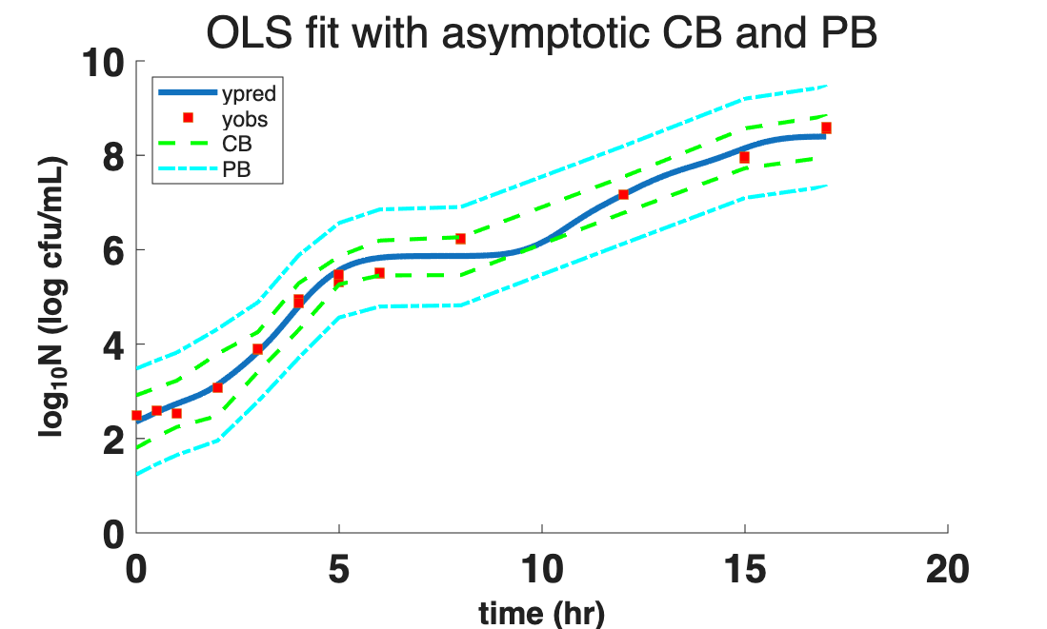
Fitted Curve with Asymptotic CB and PB
Introduction & Background Model Description Data Overview Forward Problem Parameter Selection OLS Results Model Diagnostics Optimal Experime
ntal Design Bootstrapping
Conclusions
Fig 6. OLS fit with 95% simultaneous confidence bands (CB) and prediction bands (PB)
Salmonella Gompertz Model

Slide 12
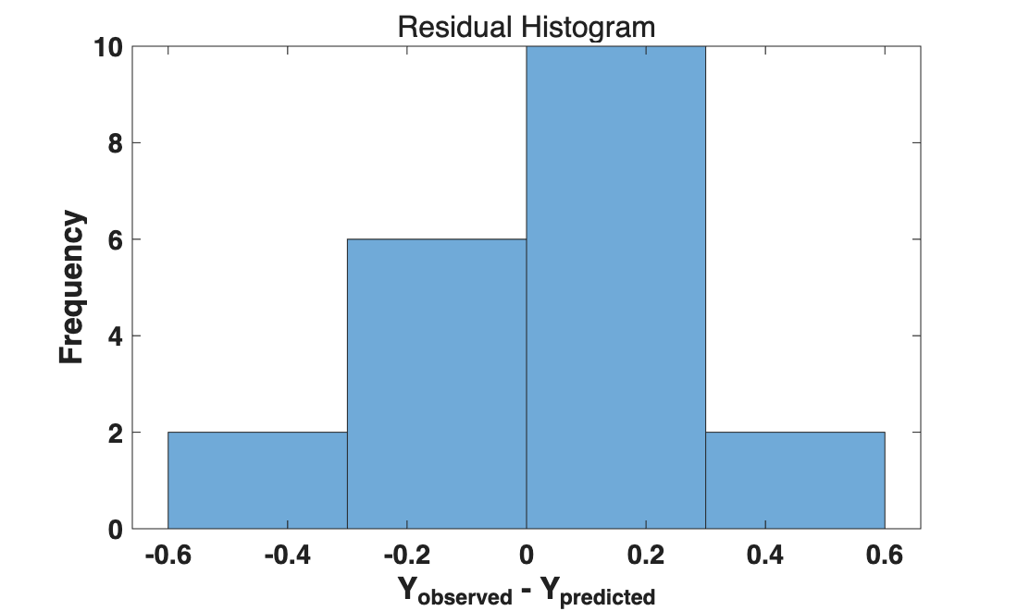
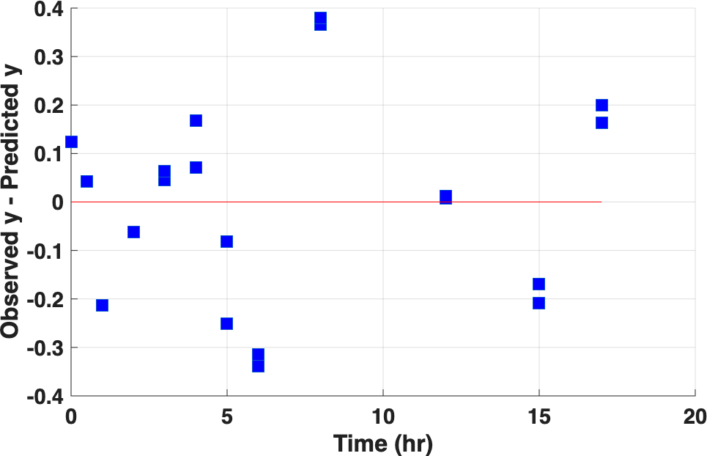
Residual Analysis
Introduction & Background Model Description Data Overview Forward Problem Parameter Selection OLS Results Model Diagnostics Optimal Experime
ntal Design Bootstrapping
Conclusions
Fig 7. Residual scatter
5 Assumptions: ✓ Zero mean (¯e ≈ 0.000)
Normality ✓ Correct model
Fig 8. Residual histogram
△ Constant variance △ Uncorrelated (runs = 6 < 10.5)
Salmonella Gompertz Model

Slide 13
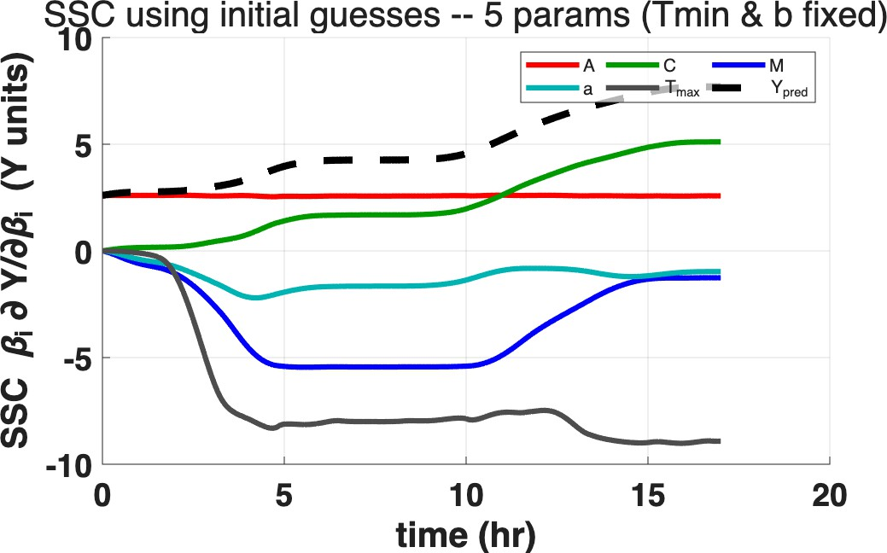
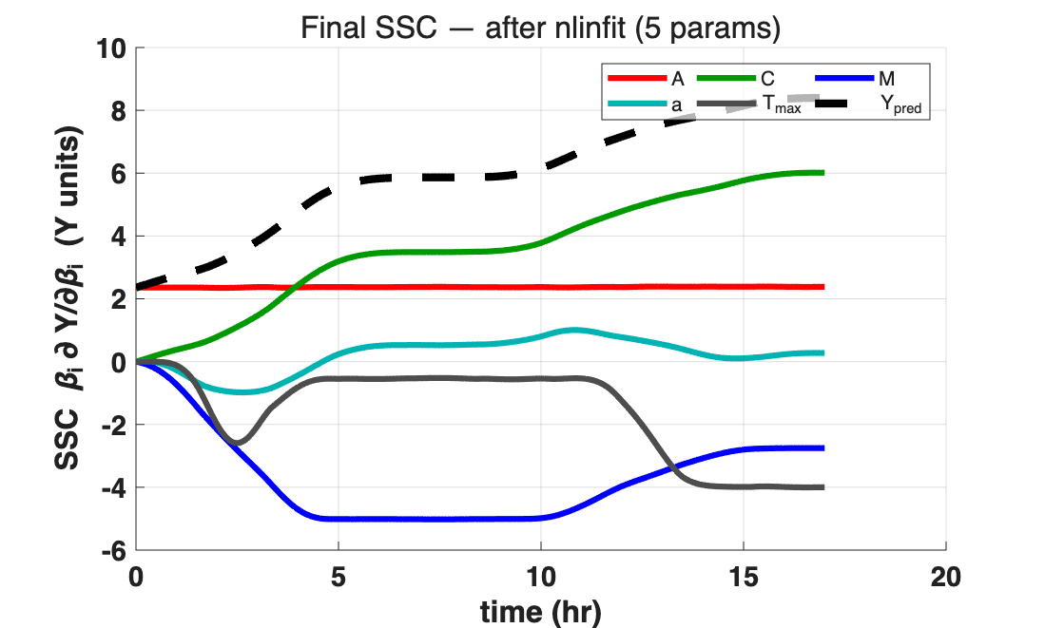
SSC Convergence —Before & After Estimation
Introduction & Background Model Description Data Overview Forward Problem Parameter Selection OLS Results Model Diagnostics Optimal Experime
ntal Design Bootstrapping
Conclusions
Fig 9a. SSC (initial guess)
Fig 9b. SSC (after OLS)
Double-check (per inv_soln5)
A, C, M: stable. a and Tmax reduced ∼50% (initial guess far from estimate), but all Max|SSC| ≥ 1 ⇒ identifiability
confirmed.
Salmonella Gompertz Model

Slide 14
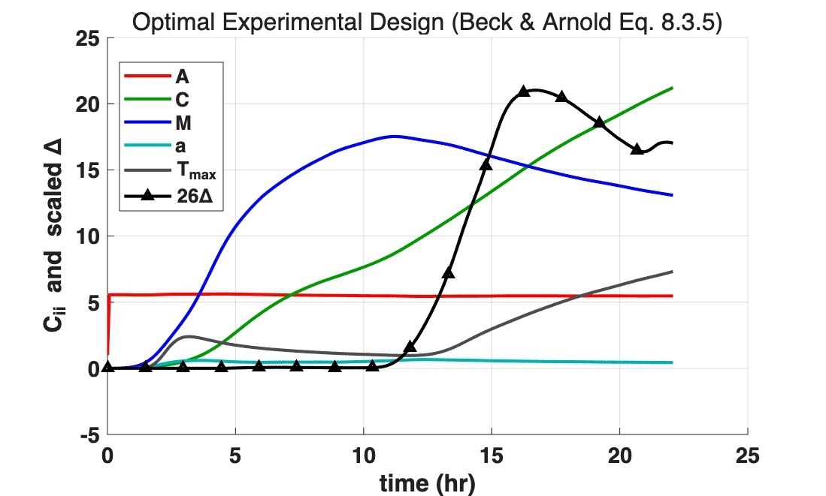
Optimal Experimental Design
Introduction & Background Model Description Data Overview Forward Problem Parameter Selection OLS Results Model Diagnostics Optimal Experime
ntal Bootstrapping
Conclusions
Beck & Arnold (1977) Eq. 8.3.5:
∫
t
1 ′ ′
C (t) = X X d
τ ,
ij
t 0 i j
∆ = det(C)
∆ peaks at t ≈ 17 hr ⇒ optimal experiment duration
C_{ii}: M peaks then declines; C
grows; a lowest
Fig 10. ∆ criterion and Cii vs. time
Salmonella Gompertz Model

Slide 15
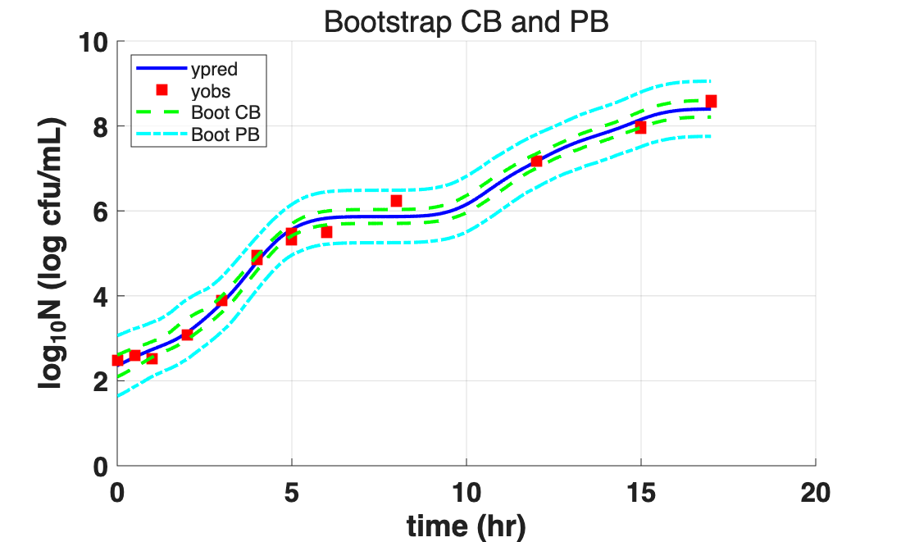
Bootstrapping of Residuals
Introduction & Background Model Description Data Overview Forward Problem Parameter Selection OLS Results Model Diagnostics Optimal Experime
ntal Design
Conclusions
600 bootstrap iterations (residual resampling), 522/600 valid.
Param
Bootstrap 95% CI
Asymptotic 95% CI
A C M
a
Tmax
[2.093, 2.606]
[10.27, 12.94]
[4.652, 5.836]
[2.5e-4, 4.4e-4]
[43.26, 152.3]
[2.046, 2.670]
[6.771, 15.354]
[4.414, 6.667]
[1.0e-4, 6.0e-4]
[26.23, 65.22]
Fig 11. Bootstrap CB and PB
Salmonella Gompertz Model

Slide 16
Asymptotic vs Bootstrap Comparison
Introduction & Background Model Description Data Overview Forward Problem Parameter Selection OLS Results Model Diagnostics Optimal Experime
ntal Design
Conclusions
Metric | Asymptotic | Bootstrap
CB width (avg) | 0.867 | 0.365
PB width (avg) | 2.119 | 1.274
Bootstrap CB is 2.4× narrower; Bootstrap PB is 1.7× narrower
Asymptotic method overestimates uncertainty (cond(J) = 3.14 × 10⁵ inflates covariance)
Bootstrap provides more realistic uncertainty quantification
Salmonella Gompertz Model

Slide 17
Conclusions
Introduction & Background Model Description Data Overview Forward Problem Parameter Selection OLS Results Model Diagnostics Optimal Experime
ntal Design Bootstrapping
1 Modified Gompertz model successfully predicts Salmonella growth under sinusoidal temperature
2 Parameter selection: SSC analysis ⇒ fix T_{min}, b (low SSC); estimate [A, C, M, a, T_{max}]
(7 → 5). R(C, T_{max}) = 0.980 but all 95% CI exclude zero
3 OLS fit: cond(J) = 3.14 × 10⁵, relRMSE = 3.84%, R² = 0.989; residual autocorrelation
(runs = 6 < 10.5)
4 Bootstrap CI narrower (2.4× for CB, 1.7× for PB) ⇒ asymptotic overestimates due to high parameter correlation
Salmonella Gompertz Model

Slide 18
References I
Introduction & Background Model Description Data Overview Forward Problem Parameter Selection OLS Results Model Diagnostics Optimal Experime
ntal Design Bootstrapping
Conclusions
[1] Lavanya Gumudavelli, Prem Rishi Velugoti, Ramaswamy C Anantheswaran, John D Floros, and Stephen J Knabel.
Dynamic predictive model for growth of Salmonella Enteritidis in egg yolk.
Journal of Food Science, 72(7):M254–M262, 2007.
Salmonella Gompertz Model

